Slide 1
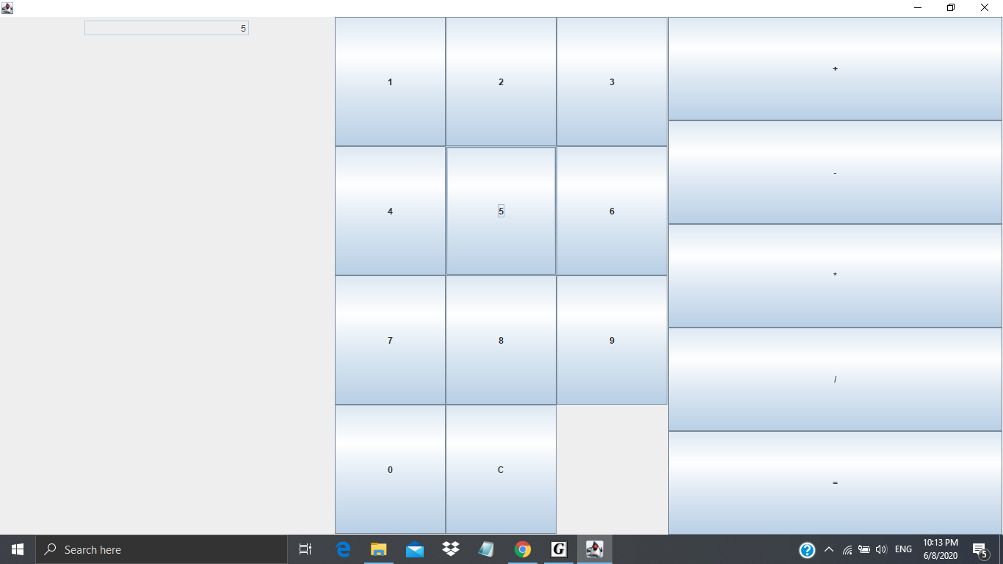
Before operation (5*2)
Choosing 5

Slide 2
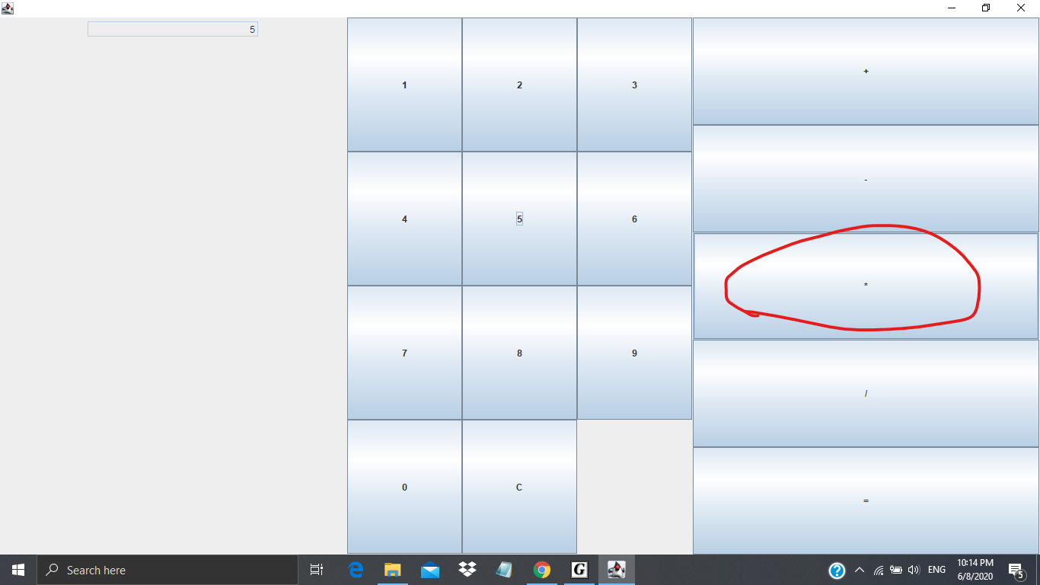
During operation choosing multiplication

Slide 3

During operation choosing 2

Slide 4

solution

